Slide 1

SWE and Hydrology

Slide 2
Wupperverband
Public authority in North Rhine-Westphalia in Germany
Responsible for the water management within the catchment area of the Wupper river
Activities comprise
  Flood protection
  Water level management

Slide 3
SWE for the Wupperverband
Use Cases:
Display of time series data for water level gauges and precipitation
Real time notification in case of exceeded alarm values
Video surveillance of rain detention basins

Slide 4
Requirements
Used for: planning, surveillance, public relations
Users: professional users and non-professionals
Background on SWE shall not be necessary
Intuitive usability
Platform independency
Performance

Slide 5
Use Case 1
Display of time series data for water level gauges and precipitation
Combined access to both types of data
Display as graphs and tables
Allow users to discover correlations
Export data (e.g. CSV, PDF)

Slide 6
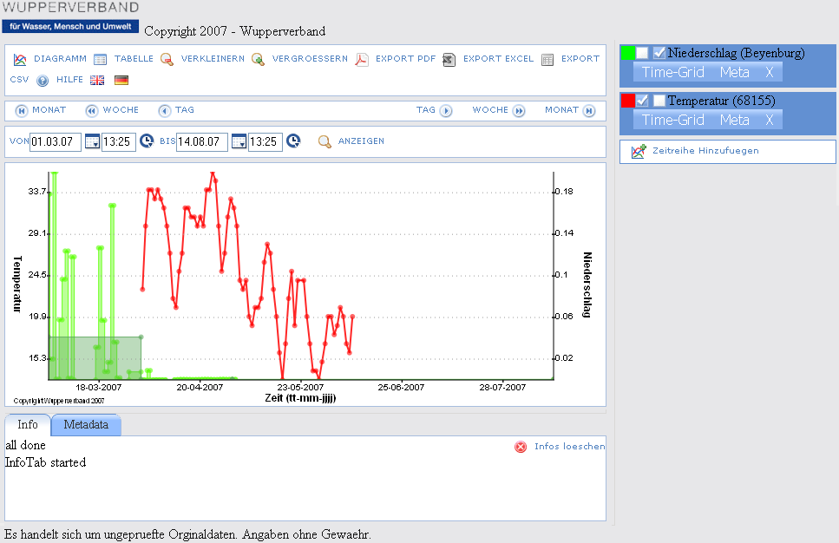
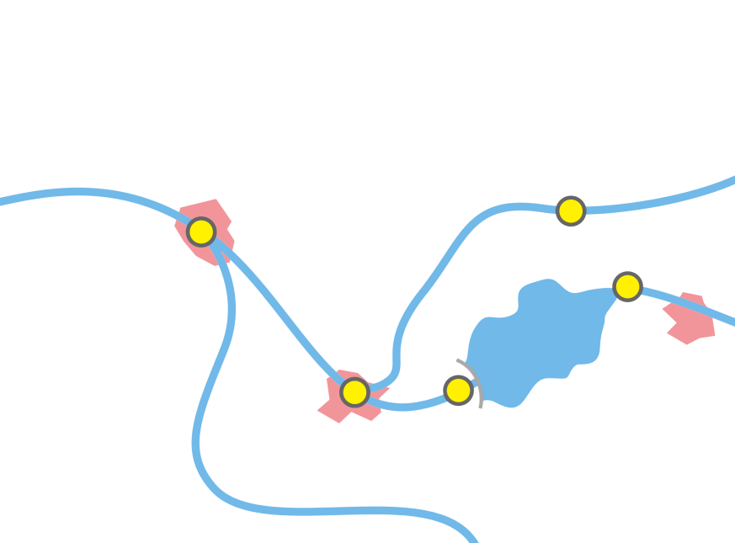
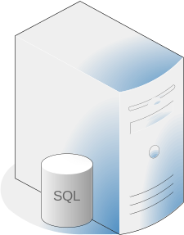
Use Case 1
SOS

Slide 7
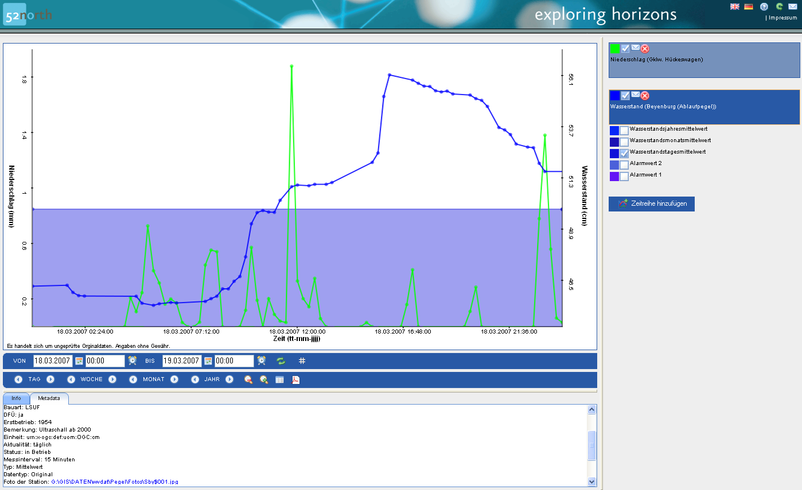

Slide 8
Use Case 2
Real time notification in case of exceeded alarm values
Define simple alert conditions, e.g.
  Precipitation higher than 30 mm/m² per hour
  Water level higher than 200 cm
Alerting via email or SMS

Slide 9
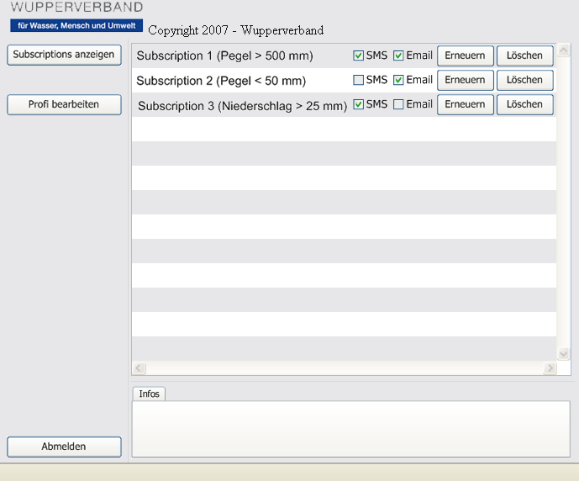

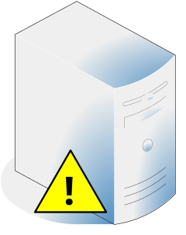
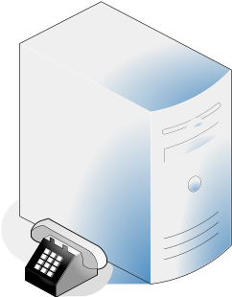
Use Case 2
SAS
WNS

Slide 10
Use Case 3
Video surveillance of rain detention basins
Controlling pan-tilt-zoom cameras
Important: Privacy issues → field of view of the cameras needs to be blocked for certain areas

Slide 11
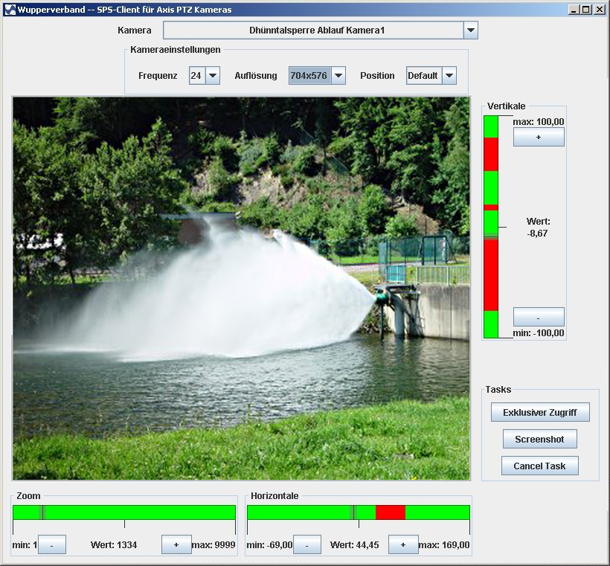
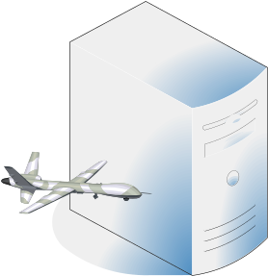

Use Case 3
SPS

Slide 12
Outlook
Client improvements with regard to usability und performance
Enhancing the SOS by further operations
Support of further communication protocols by the WNS
Integration of security components
Enhanced display capabilities (combination of time series and map display)

Slide 13
Conclusion
OGC SWE services can effectively be used within the domain of water management
The user does not need extensive technological knowledge and experience
Potential for further enhancements in the future

Slide 14
Thank you for your attention!

